Slide 1

Salary Prediction Project
By: Akash Jana
DATA SCIENTIST

Slide 2
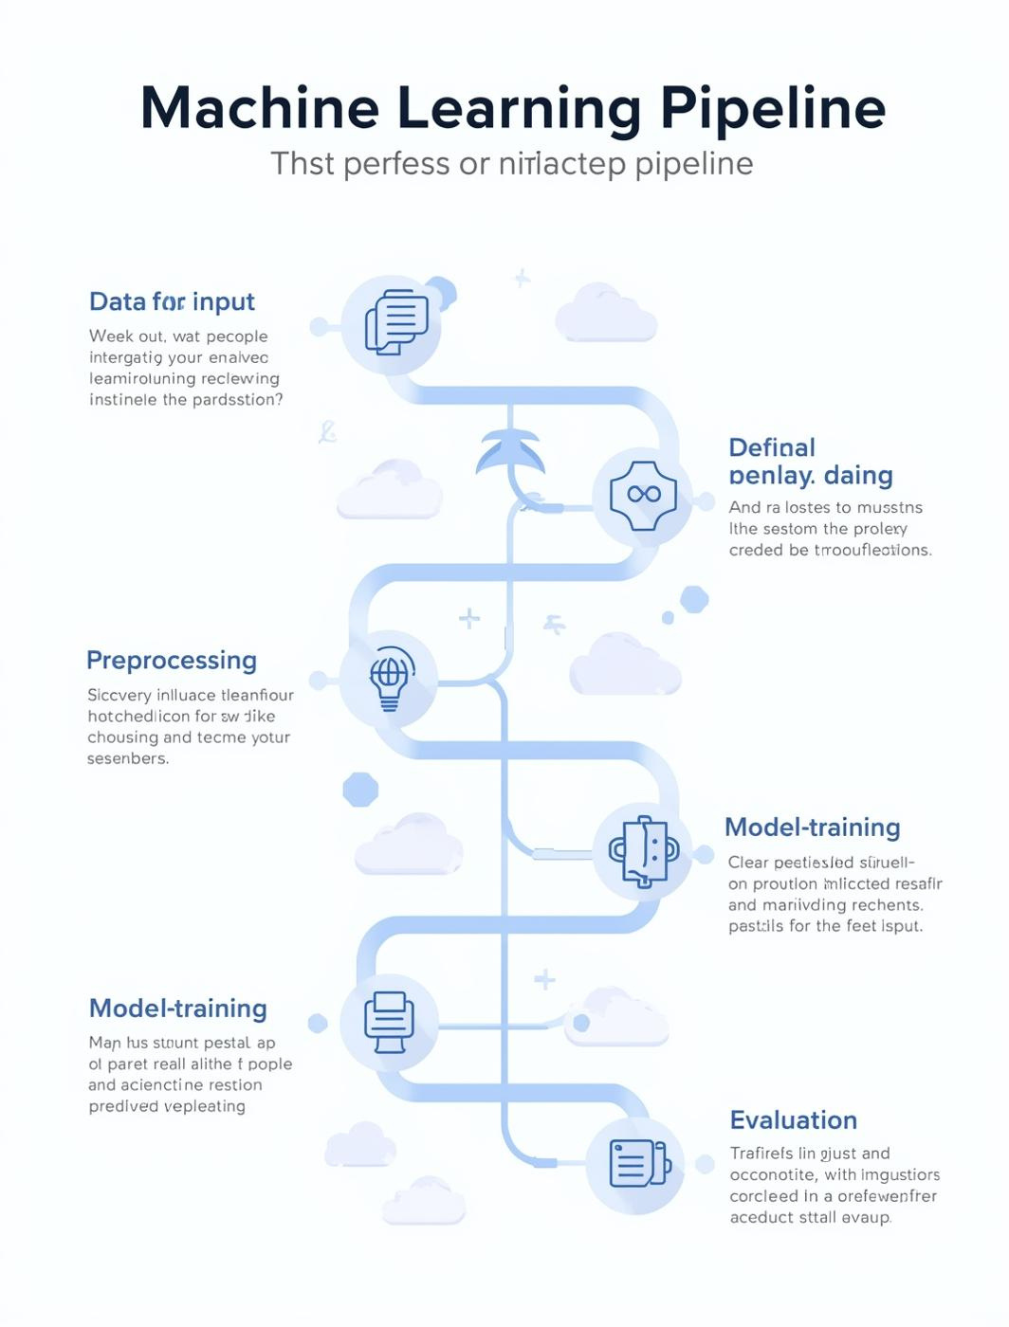
Project Overview
Analyzing and predicting salaries through a comprehensive ML pipeline approach.
This presentation delves into the intricate process of predicting average salaries using machine learning. We will explore the various stages of the ML pipeline, including exploratory data analysis, data cleaning, feature engineering, model building, and finally, evaluation of the model's performance to extract meaningful insights.

Slide 3
25,000 Average Salary
Annual salary data analyzed
12 Columns
Key features in dataset
8% Missing Values
Data needs cleaning

Slide 4
Data Cleaning
Addressing issues in the dataset
Missing Values
Duplicates
Outliers
We identified and handled missing values by employing imputation techniques, ensuring that the integrity of our dataset remained intact while minimizing data loss.
Duplicate entries were detected and removed to maintain accurate data representation, thereby preventing bias in our analysis and ensuring valid model training.
Outliers were assessed and treated using statistical methods, ensuring they did not skew our results and that the model could perform optimally across all data points.

Slide 5
Preprocessing Steps
Transforming Data for Effective Modeling
Encoding Techniques
Feature Scaling
Data Splitting
Categorical variables were converted into numerical formats using techniques like one-hot encoding, ensuring that the model can interpret the data effectively without losing information.
Features were standardized using Min-Max scaling to ensure uniformity, allowing algorithms to converge faster and perform optimally across various ranges within the dataset.
The dataset was divided into training and testing sets, using an 80/20 split to evaluate model performance accurately and prevent overfitting during the training process.

Slide 6
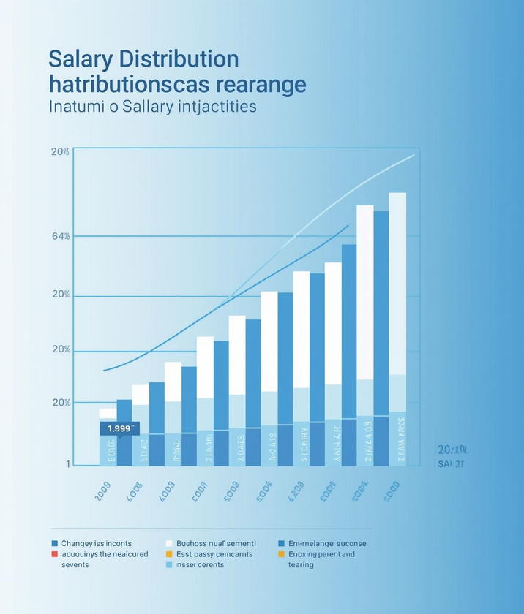

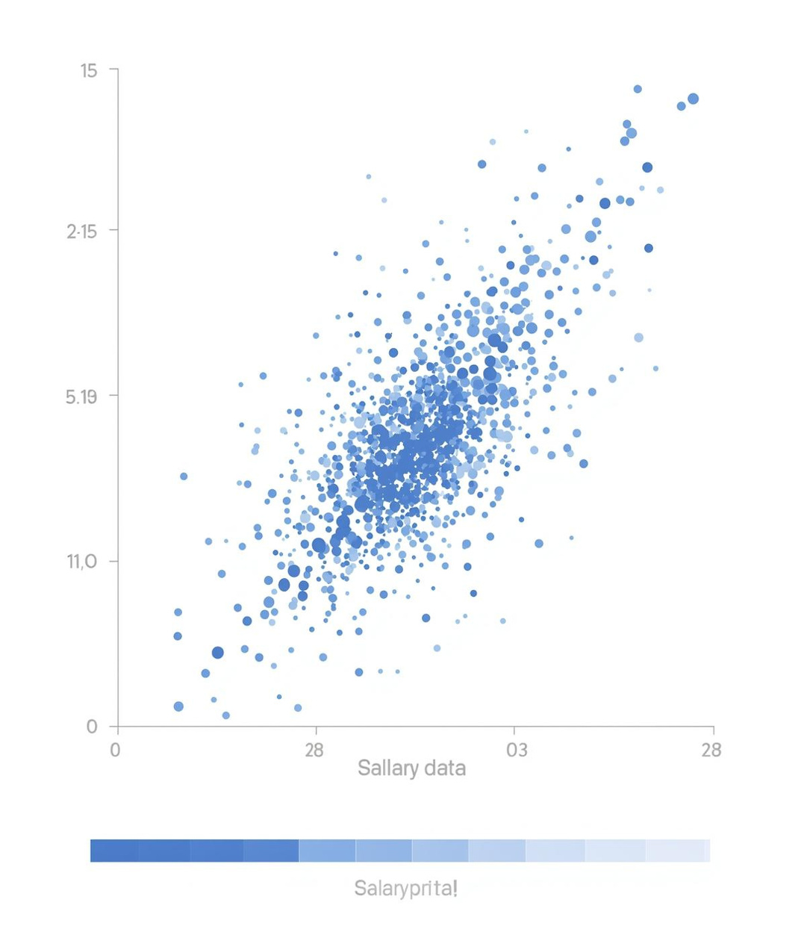
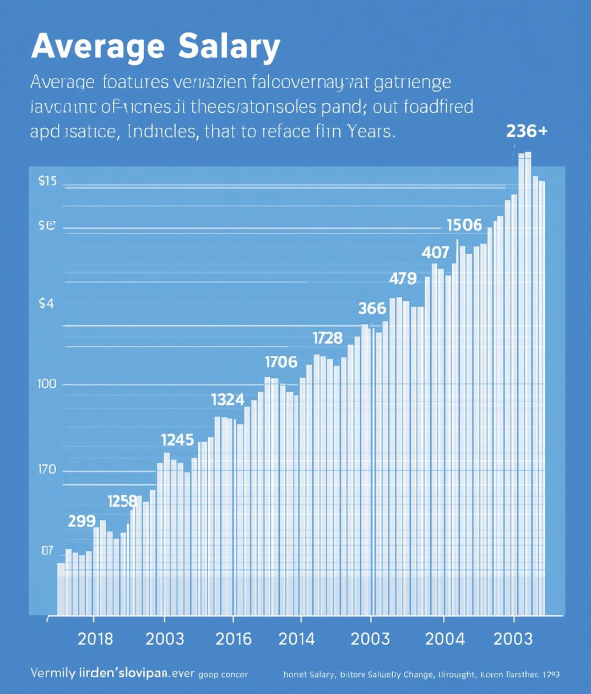
Exploratory Insights
Salary Distribution
Skill Correlations
Outlier Impacts
Trends Over Time
Visual representation of salary ranges
Insights on skill impact on salary
Effects of extreme values on data
Salary changes across different years

Slide 7
Model Building
Overview of algorithms and training setup
In this section, we explore the various algorithms implemented for predicting average salaries. The chosen models include linear regression, decision trees, and random forests. Each model was carefully evaluated based on its training setup, including feature selection and cross-validation techniques, ensuring optimal performance and robust predictions throughout the ML pipeline.

Slide 8
Hyperparameter Tuning
Optimizing Model Performance with Techniques
Hyperparameter tuning is crucial for enhancing model accuracy. In this project, we utilized GridSearch and RandomSearch techniques to systematically explore various combinations of hyperparameters. By identifying the optimal settings for each model, we achieved significant improvements in performance metrics, ensuring a robust and reliable salary prediction model. This process is essential for maximizing predictive capabilities.

Slide 9

R²
The R² value indicates how well our model explains the variance in salary data, reflecting its effectiveness in predicting average salaries for different factors.

Slide 10
WEBSITE
IBM_salary_predictor
Salary Prediction
Thank you!
EMAIL
akashjana.at.btech@gmail.com
PHONE
+91 7427984933

